Slide 1
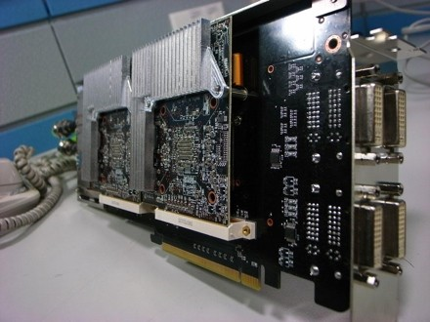
Multi-GPU Programming Pros and Cons: A Case Study
Ravishka Rathnasuriya Dr. Eduardo Colmenares Midwestern State University, Texas Department of Computer Science

Slide 2

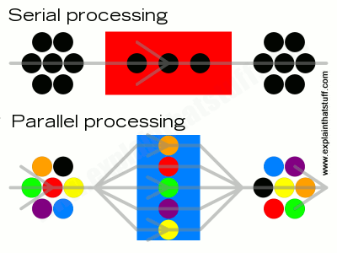
What is a Supercomputer?
A computer with high level of performance compared to a general-purpose computer
Use to perform parallel processing
Knowledge of parallel computing is helpful to take advantages of the power of the supercomputers.
Accessed the Maverick2 Supercomputing Cluster at
Texas Advanced Computing Center

Slide 3
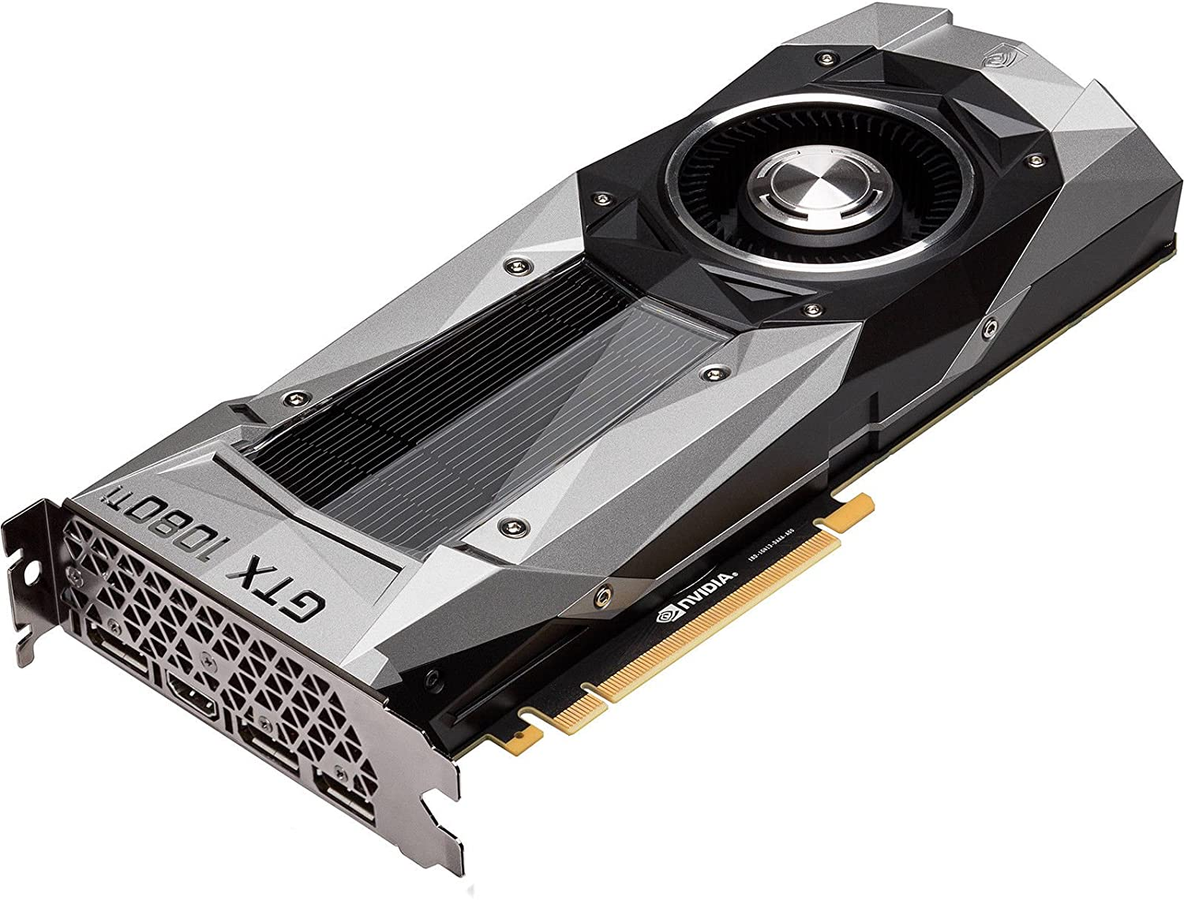
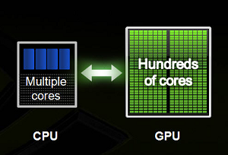
What is a GPU?
Graphics Processing Unit
Part of modern Supercomputing
Powerful in parallel computing. Ability to shrink large number and compute in seconds.
Break complex problems into thousands or millions of separate tasks and work them out at once.
Many cores. Number of operations processed per second is high. (high throughput).
CUDA a parallel computing platform let programmers to take advantage of computing the power of GPUs.

Slide 4
Project Objective
Write programs for Sequential , 1-GPU, 2-GPU versions.
A study on the positive and negative aspects of using multiple GPU’s in solving problems with larger data sets
Identify the variations of program’s performance with increasing size of data samples of Sequential vs 1-GPU vs 2-GPU programming.
Achieving communication-communication and computation –computation parallelism between GPUs while moving from Multi-Core to Many-Core programming.
Used C programming for sequential programming, and CUDA in C for GPU programming.

Slide 5
Device Properties
Device name: GeForce GTX 1080 Ti
Total global memory: 11721506816 bytes
Size of shared Memory per block : 49152 bytes
Number of registers per block: 65536
Corresponding Warp Size: 32
Maximum number of threads per block: 1024
Maximum Number of threads that we can have for a 3D layout: x:1024 y:1024 z:64
Maximum grid size: x:2147483647 y:65535 z:65535
Number of Multiprocessors: 28

Slide 6
Software Used
Visual Studio Code – Text Editor
WINSCP Connect to the cluster Store files and execute jobs
PUTTY Compile the programs
TACC Visualization Portal To use NVIDIA Visual Profiler

Slide 7
Compilation and Execution Commands
Compilation Commands gcc <file_name.c> -o a.out nvcc <file_name.cu> -o a.out
Execution Commands sbatch <script_file>

Slide 8
Problem Sizes
Each Matrix has three contain three different sizes
Small Size – 16384 elements
Medium Size – That fits the size of 1-GPU 536,870,912 elements
Large Size – That goes beyond the size of 1-GPU 1,073,741,824 elements

Slide 9
From 1-GPU to 2-GPU
Conditions that should satisfy to obtain concurrency between multi-GPUs
Use non-default streams. Stream is a sequence of operations that execute on the device in order. cudaStream_t stream[2]; cudaStreamCreateWithFlags(&stream[0],cudaStreamNonBlocking); MatrixAddition<<<dimGrid, dimBlock,0,stream[0]>>>(matAD[0],matBD[0], matCD[0]);
Use asynchronous commands for memory copies. cudaMemcpyAsync(matAD[0], &matAP[0*size/2], totalsize/2, cudaMemcpyHostToDevice,stream[0]); cudaMemcpyAsync(matAD[1], &matAP[1*size/2], totalsize/2, cudaMemcpyHostToDevice,stream[1]);
Host memory involved in data transfer must be pinned memory. cudaMallocHost((void**)&matAP,totalsize);

Slide 10
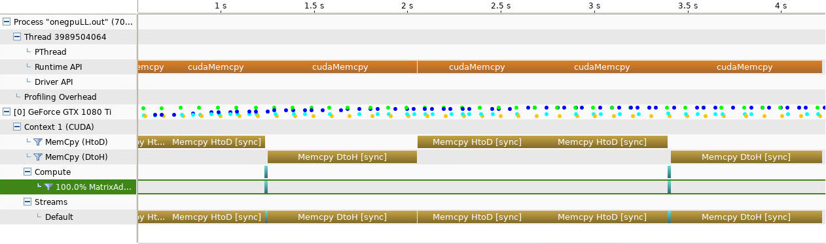
Visual Profiler for Large Size 1-GPU

Slide 11
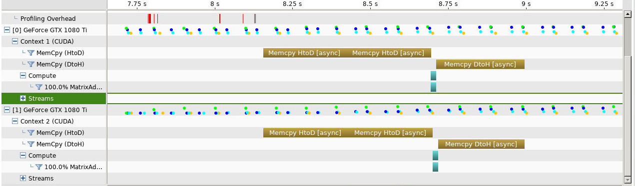
Visual Profiler for Large Size 2-GPU

Slide 12

Performance Analysis

Slide 13
Execution Time(milli seconds)
Execution time (milli seconds)
Method | Problem Sizes (# of elements a matrix contain)
 | 16384 | 536870912 | 1073741824
Sequential | 0.058463 | 1955.696896 | 4532.541298
1-GPU | 0.030976 | 17.705025 | 35.487232
2-GPU | 0.001632 | 8.84928 | 17.65814

Slide 14
Execution Time Curve

Slide 15
Speed Up Table (Ts / Tp)
Speed up(Ts/Tp)
Method | Problem Sizes
 | 16384 | 536870912 | 1073741824
Sequential | 1 | 1 | 1
1-GPU | 1.887364411 | 110.4599907 | 127.7231568
2-GPU | 35.82291667 | 221.0006798 | 256.6828272

Slide 16
Speed Up Curve

Slide 17
Pros of Multi-GPU Programming
The execution time for a task becomes more faster than using 1-GPU in large data sets.
2 or more GPU’S can communicate with each other, reducing the time for communication between host-device
Multi-GPUs can execute parallelly which optimized performance of the program
Communication-communication and computation-computation parallelism can be achieved between GPUs.

Slide 18
Cons of Multi-GPU Programming
CudaMallocHost that would allocate memory in the host would take more time.
Power and energy for using Multi-GPUs is relatively higher than a single GPU

Slide 19
Acknowledgement
Dr. Magaly Rincon
Julie Scales and UGROW Committee
Dr. Eduardo Colmenares
Department of Computer Science, MSU
Texas Advanced Computing Center
NVIDIA

